Slide 1

Reddit Graph Analysis
By Kyle Arbide

Slide 2
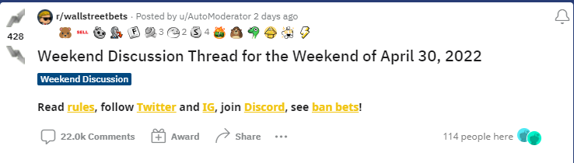
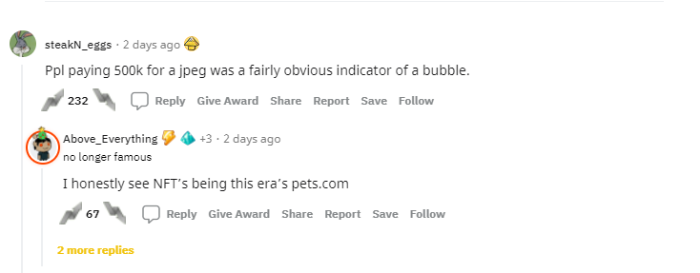
Data Description
Data was collected from r/wallstreetbets
Contains information from posts and comments on the subreddit
Data was collected between 3/28/21 - 4/5/21
Dataset contains:
598 posts
13552 comments
Original data has a JSON-like format

Slide 3
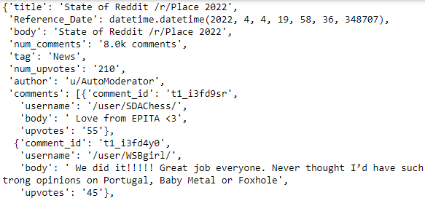
Data Cleaning
There were a few key steps needed to clean the data:
num_comments and num_upvotes fields need to be converted to int dtypes
Datetime types not accepted in arango, need to be converted to stings
Usernames are formatted differently for posts and comments, converted to display just the username for both

Slide 4
Deciding between JSON and Graph Database
JSON
Graph
Pros:
Data is already in a JSON representation
Simpler query language
High performance (fast)
Cons:
Difficult to understand the relationships between documents
Pros:
Much easier to understand relationships between nodes
Collection formatting requires a bit more work, but it is still relatively simple
Cons:
AQL is slightly more complicated

Slide 5
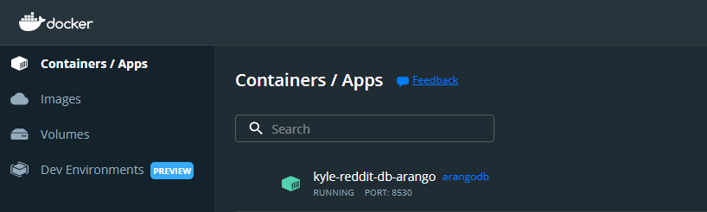
Docker
I decided to use Docker to spin up my database. Some of the benefits of using Docker are:
Can be easily created, spun-up, and shut-down
Docker containers are portable, can easily be deployed on another system
Docker APIs allow for quick and easy scaling
Unlike Virtual Machines, Docker containers are not accessible through the internet

Slide 6
Schema

Slide 7
Graph 1 - ‘Reddit’
Posts
title
datetime
num_comment
num_upvotes
body
tag
All Vertex Collections contain _id and _key fields
All Posted Collections contain _id, _from and _to fields
Posted
Commented_On
Users
username
Comments
body
upvotes
Commented

Slide 8
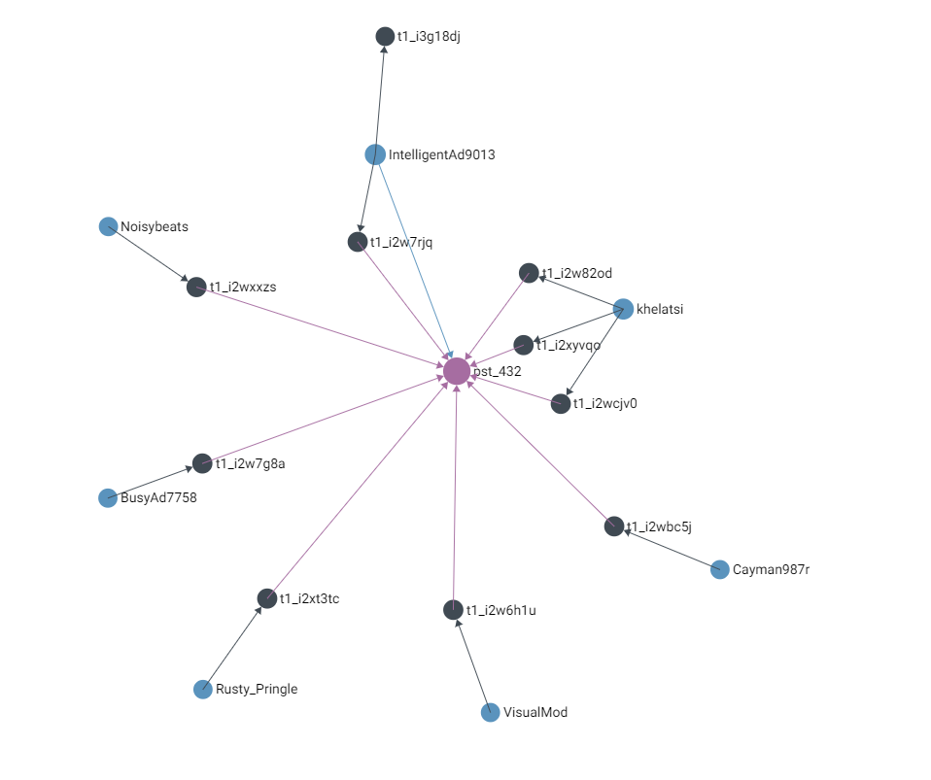
Arango Representation - 1
Legend:
Users
Posted
Comments
Commented
Posts
Commented_On
Depth: 2
Starting Node: pst_432

Slide 9
Graph 2 -
‘Reddit_w_Threads’
Posts
title
datetime
num_comment
num_upvotes
body
tag
Our dataset also has information on how
comments appear in a thread. This means
we can add another edge to the graph.
Posted
Commented_On
Users
username
Comments
body
upvotes
Comment_Thread
Commented

Slide 10
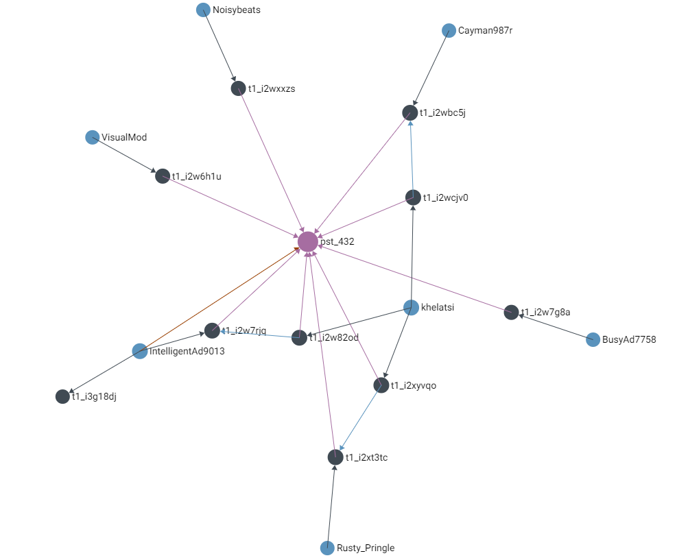
Arango Representation - 2
Legend:
Users
Posted
Comments
Commented
Posts
Commented_On
Commented_Thread
Depth: 2
Starting Node: pst_432

Slide 11
Queries & Traversals

Slide 12
Queries
The following questions were answered using simple queries created with AQL:
Number of Posts with >300 Upvotes
post in posts
filter post.num_upvotes > 300
collect with count into upvotes
return upvotes
Returns: 170
Number of Comments with >300 Upvotes
for comment in comments
filter comment.upvotes > 300
collect with count into num_upvotes
return num_upvotes
Returns: 174
Number of Users with >5 Comments
for doc in commented
collect user = doc._from
aggregate num_comments =
count_distinct(doc._to)
filter num_comments > 5
collect with count into num_users
return num_users
Returns: 339
Notes:
About 7,000 total users

Slide 13
More Queries!
Top 5 Upvoted Posts
for post in posts
sort post.num_upvotes desc
limit 5
return {[post._id]:post.num_upvotes}
Returns:
{'posts/pst_176': 332}, {'posts/pst_444': 331}, {'posts/pst_445': 331}, {'posts/pst_446': 331}, {'posts/pst_447': 331}
Top 5 Users Based on Number of Comments
for doc in commented
collect user = doc._from
aggregate num_comments = COUNT_DISTINCT(doc._to)
sort num_comments desc
limit 5
return {[user]: num_comments}
Returns:
{'users/VisualMod': 414}, {'users/AutoModerator': 191}, {'users/Dfree707': 64}, {'users/MoneyManToTheMoon': 44}, {'users/limethedragon': 40}

Slide 14

Traversal 1 -Daily Discussion
Question: How far does the Discussion from Daily Discussion posts extend out into the subreddit?
Uses:
Graph 1 : ‘Reddit’
Criteria:
Includes all users who commented on a daily discussion post.
If a commenter created a post, it includes all users who
commented on their post.
Result:
117 Users
1.7% of Users (6,868 Total Users)

Slide 15

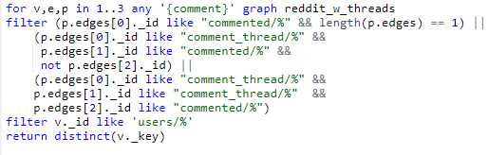
Traversal 2 -Topic Discussion
Question: How many users are participating in conversations about a given topic. In this case GameStop!
Uses:
Graph 2: ‘Reddit_w_traversals’
Criteria:
Any user who posts or comments about GameStop
Any user who comments on a post about GameStop
Any user who comments in a comment thread about
GameStop
Result:
1537 Users
22.38% of Users (6,868 Total Users)
If we had only included users that directly mentioned GameStop, it would have been 563 users (8.2%). Much less!
Pull the GME comments
Loop Through the comments and pull users from the thread

Slide 16
Conclusion
Using an Arango Database made it much easier to analyze the relationships between users, posts, and comments.
We have the choice between multiple graphs (with comment threads or without).
In the GameStop example, using extended relationships changed the results drastically.
Docker provided easy functionality to create, spin-up, and shut-down the database.
Gitlab: https://gitlab.com/c6831/2022_spring/kyle_reddit_graph_db/-/blob/main/raw_data_merge_and_prep.ipynb

